Slide 1
Data Publication 101
DOZA
UNIVERSITY LIBRARY / Universiteitsbibliotheek

Slide 2
outline
What is data publishing?
Why data sharing?
Data sharing policy
Data sharing using repositories
What is a data repository?
Examples
How repositories lead to FAIR and/or open data (metadata, persistent identifiers, standards)
How to select a data repository?
How to use a data repository
Data re-use, data citation, licenses
Biblio data register (refer to demos)

Slide 3

Publishing data
Sharing data from
completed (parts of) research projects
outside your project or research team.
Not
exchanging data with collaborators while your research is active.
Share data with your promotor

Slide 4
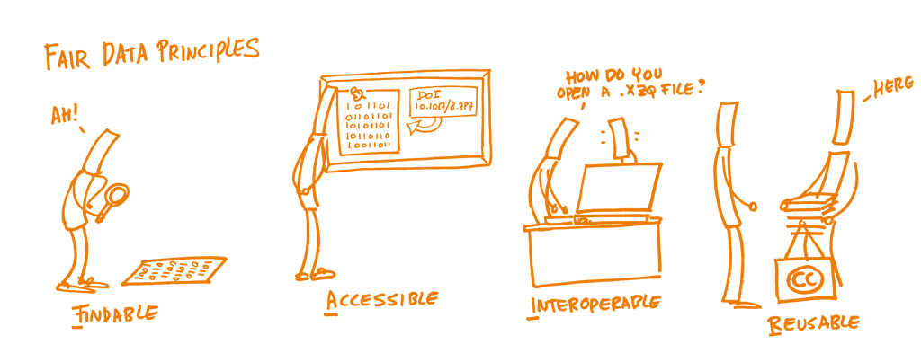
Rationale for developing fair principles
Urgent need to improve the infrastructure supporting the reuse of research data
Specific emphasis on enhancing the ability of machines to automatically find and use the data, in addition to supporting its reuse by individuals
The FAIR principles are a guideline to enhance the data reusability
https://book.fosteropenscience.eu/
Wilkinson, M., Dumontier, M., Aalbersberg, I. et al. The FAIR Guiding Principles for scientific data management and stewardship. Sci Data 3, 160018 (2016). https://doi.org/10.1038/sdata.2016.18

Slide 5
Why share data?

Slide 6
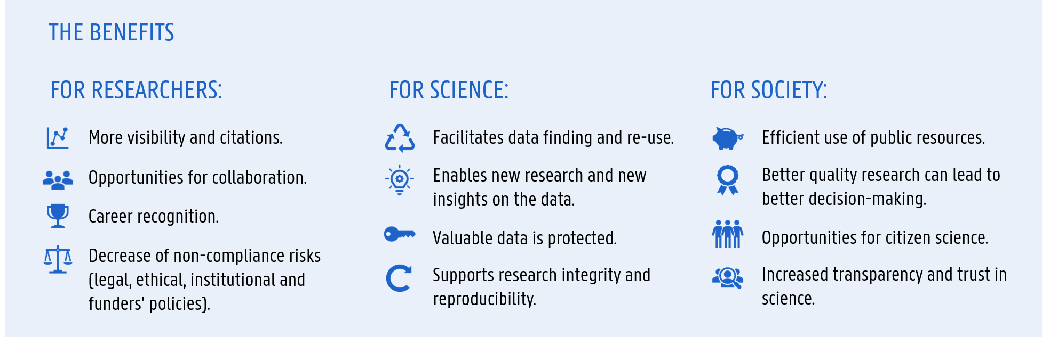

Slide 7


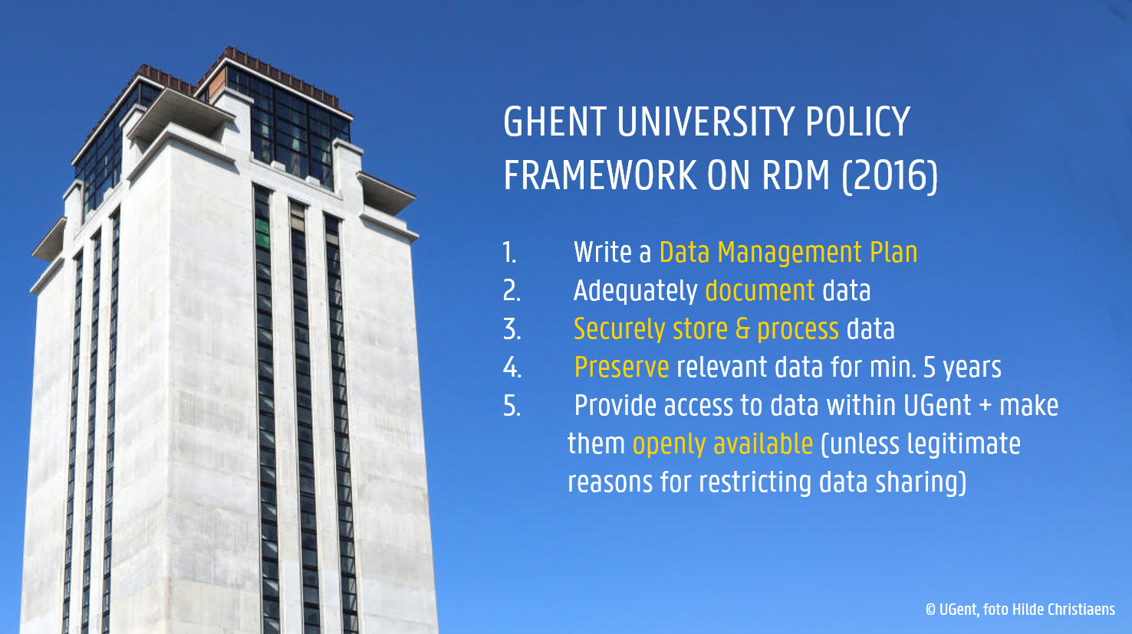
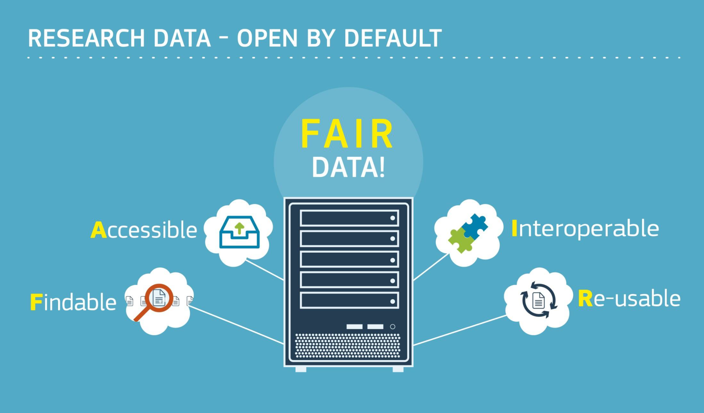



Policies and requirements on data sharing
Institutional policies
HEU Open Science requirements
Journals & publishers
ALLEA European Code of Conduct for Research Integrity
“PLOS journals require authors to make all data necessary to replicate their study’s findings publicly available without restriction at the time of publication. When specific legal or ethical restrictions prohibit public sharing of a data set, authors must indicate how others may obtain access to the data.” PLOS ONE Data availability
Access as open as possible, as closed as necessary
Data as legitimate and citable products of research

Slide 8

RDM = key part of FWO policy for all support channels
“Sound data management is required for all research supported by the FWO.”
Specific expectations:
preserve data for a minimum of 5 years after end of research
submit a Data Management Plan
encourages researchers to ensure that their data management complies as much as possible with the 'FAIR' principles
advises researchers to apply the principle 'as open as possible, as closed as necessary'
Reporting
the FWO obliges to register all relevant output in the FRIS database via the institutional systems
https://www.fwo.be/en/the-fwo/research-policy/data-management-plan/ https://www.fwo.be/en/the-fwo/research-policy/reporting/

Slide 9
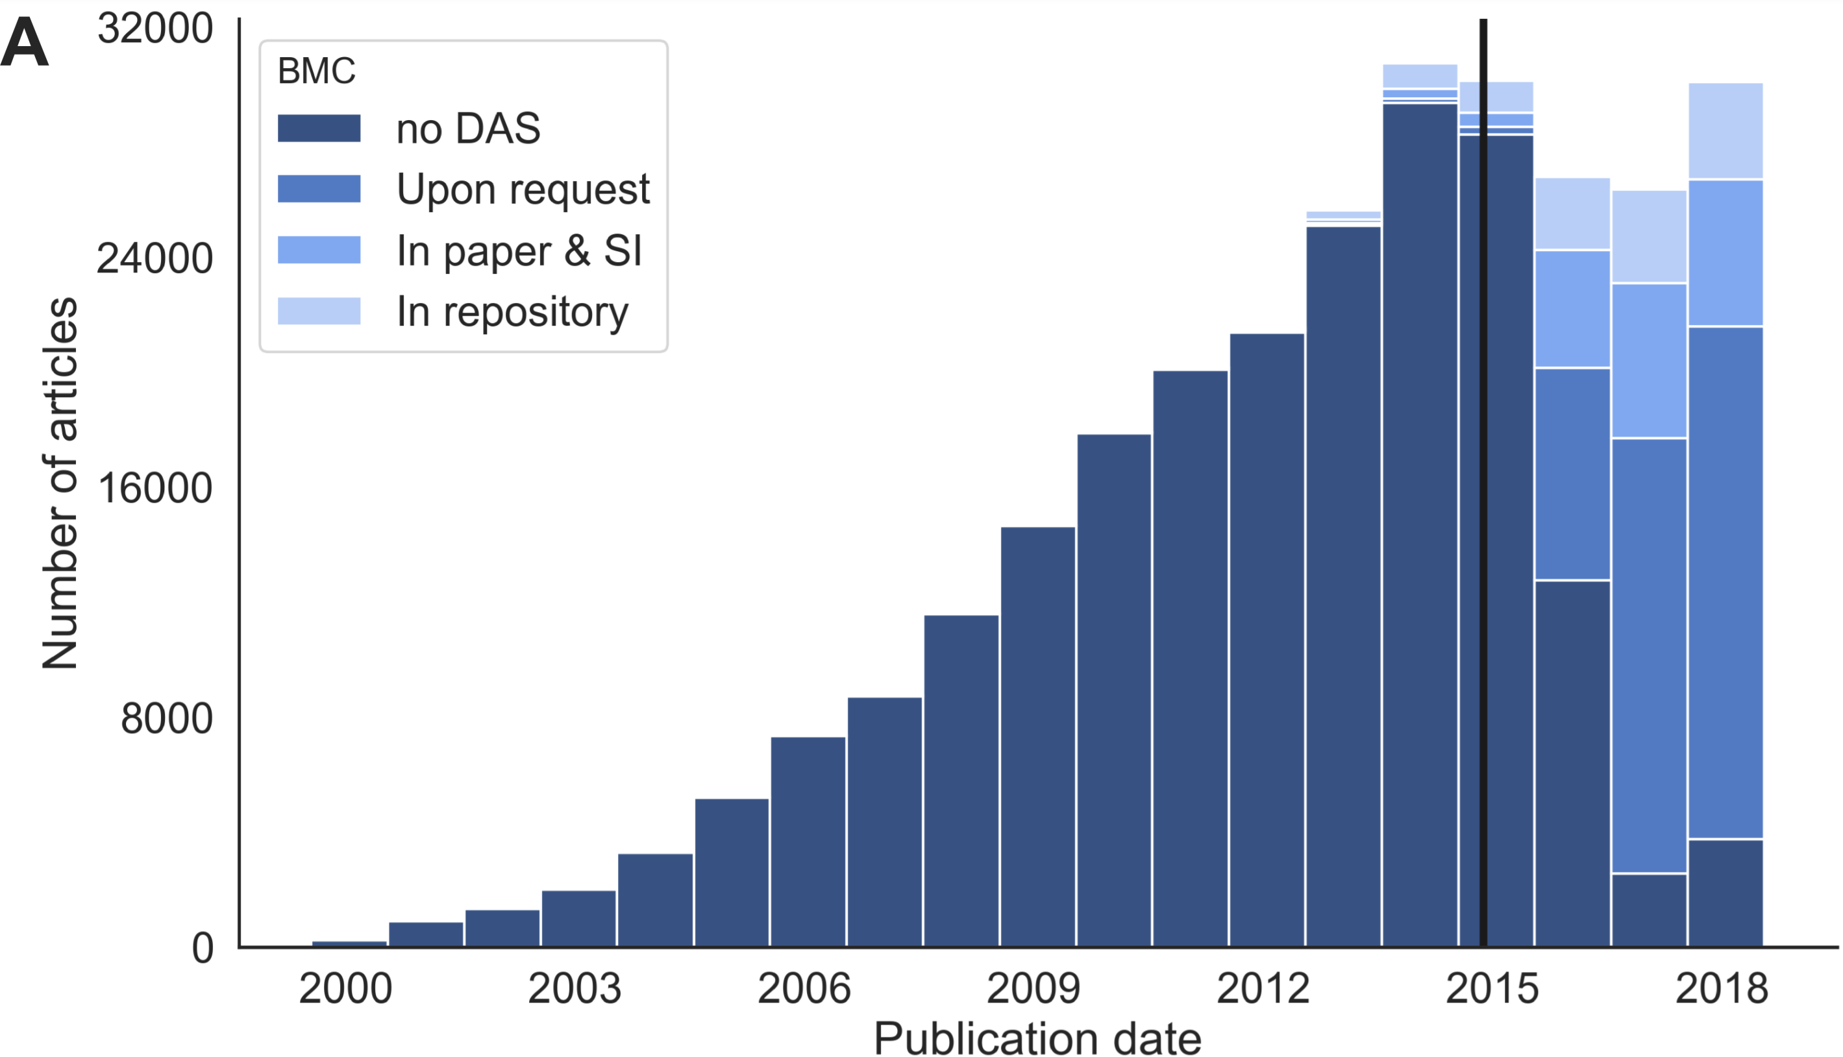
JOURNALS: Data availability statements
Colavizza, Giovanni & Hrynaszkiewicz, Iain & Staden, Isla & Whitaker, Kirstie & Mcgillivray, Barbara. (2019). The citation advantage of linking publications to research data.
Subset of Fig 2. Data availability statements over time. A = all BMC articles. The vertical solid line shows the date that the publisher introduced a mandated DAS policy.

Slide 10
Ways of sharing data

Slide 11
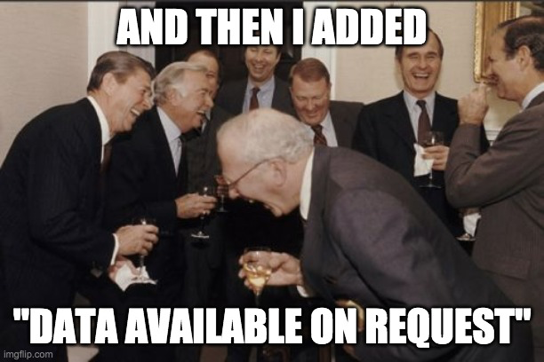
Data upon request
Often unavailable
Recent research has found that as little as 6,8% of data was readily made available upon request
Only 14% responded
https://figshare.com/articles/presentation/Handson_fMRI_code_and_data_sharing/12911165/1
Gabelica et al. 2022, https://doi.org/10.1016/j.jclinepi.2022.05.019

Slide 12

ways of sharing data
Upon request
Personal or project website
Article suppl. material
Data repository or archive

Slide 13
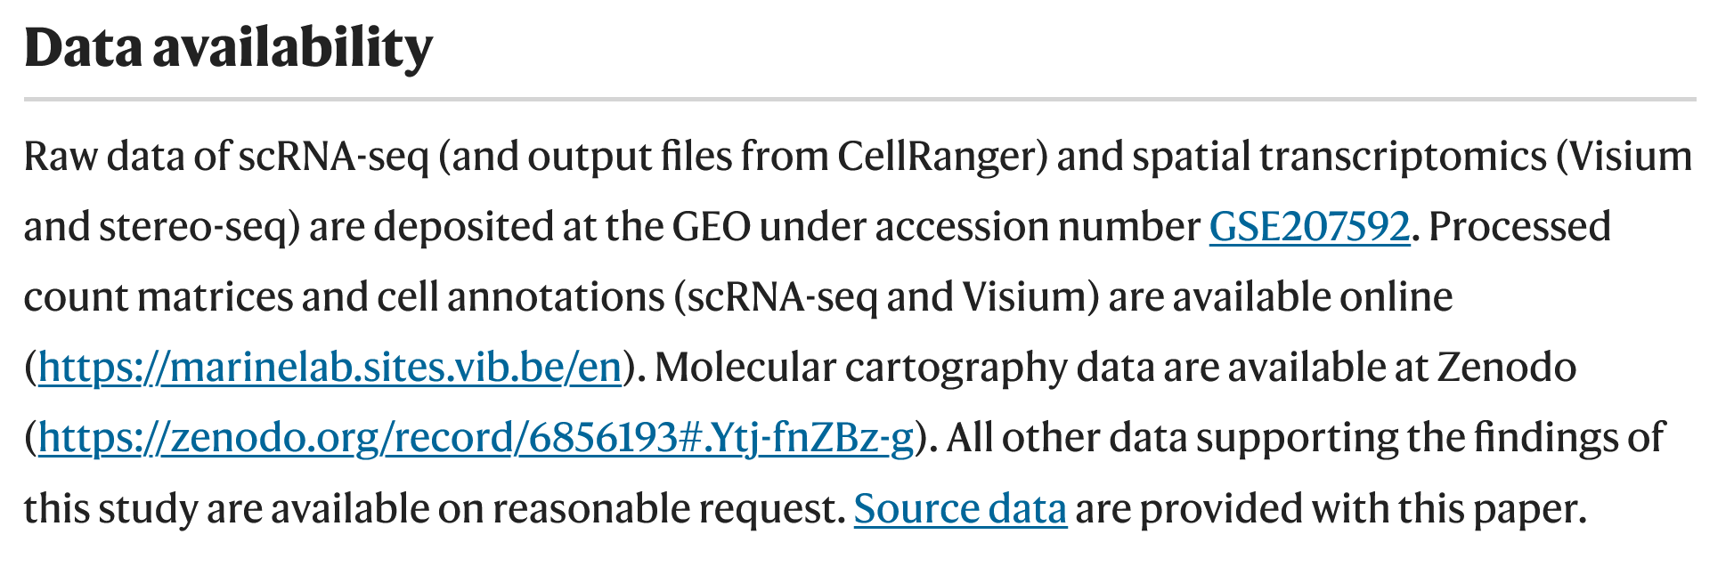
Data linked to article publication
Karras, P., Bordeu, I., Pozniak, J. et al. A cellular hierarchy in melanoma uncouples growth and metastasis. Nature 610, 190–198 (2022). https://doi.org/10.1038/s41586-022-05242-7

Slide 14
FAIR Data in repositories

Slide 15

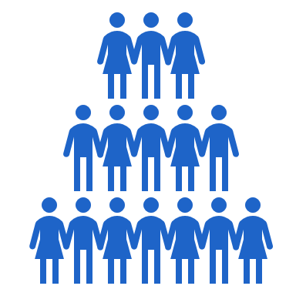







What is a data repository?
A database infrastructure that collects, manages and stores data for preservation and sharing
I want to share my data
I want to find and re-use data
Persistent identifiers
Researcher
Scientific community
Data access conditions
Long term preservation
Data reuse conditions
Data curation and/or QC
Standardization
Notes:
It is a more generalized term, favored when the specific type of data storage entity is not known or is irrelevant to the context. The purpose of a data repository is to keep a certain population of data isolated so that it can be mined for greater insight or business intelligence or to be used for a specific reporting need. (Informatica)

Slide 16
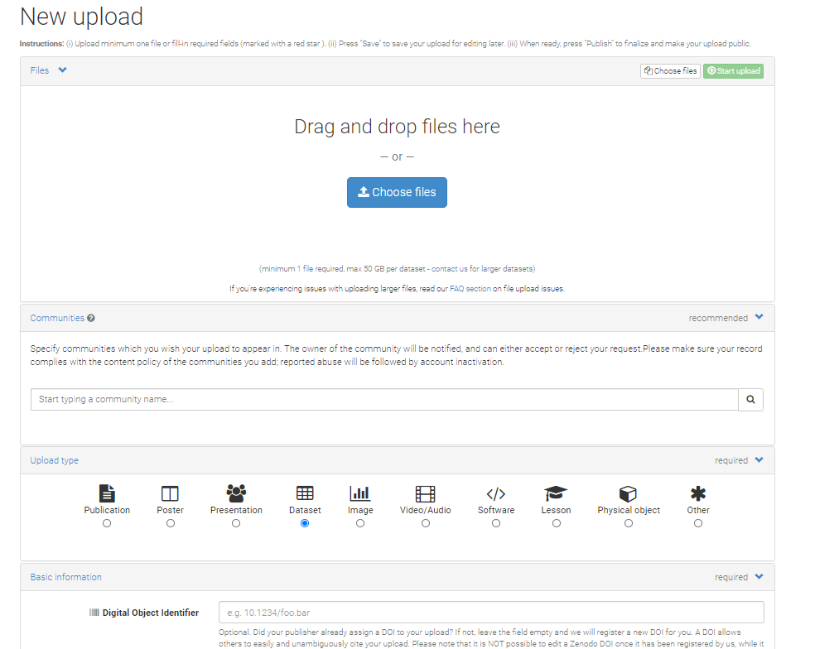
Exploring data repositories
Some repositories have a test environment: sandbox.zenodo.org/ (vs. zenodo.org/)

Slide 17

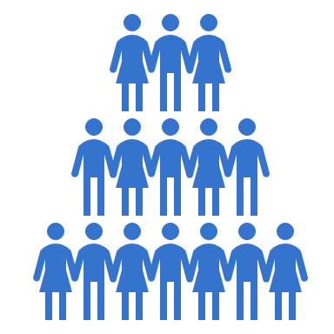





WHAT IS A DATA REPOSITORY?
A database infrastructure that collects, manages and stores data for preservation and sharing
FAIR
DATA
FINDABILITY
RESEARCH COMMUNITY
SUPPORT
PERSISTENT & UNIQUE IDENTIFIER
FAIR
FAIR
FAIR
FAIR
LONG TERM
DATA PRESERVATION
DATA ACCESS CONDITIONS
DATA RE-USE CONDITIONS

Slide 18
Data repositories & FAIR DATA
→ Key infrastructures that provide functionalities to make your data FAIR.
→ Shared responsibilities between repositories and researchers in making data FAIR
FAIR principle | In practice | Repository | Researcher
FINDABLE | Assign a persistent identifier (PID) | ●
 | Data are described with rich metadata | ● | ●
 | Metadata include the PID, are indexed & searchable online | ●
ACCESSIBLE | (Meta)data retrievable via PID using a standardised communications protocol (e.g. html) | ●
 | Authentication and authorisation procedure | ●
INTEROPERABLE | Metadata standards | ●
 | Controlled vocabularies | ● | ●
 | References to other (meta)data | ● | ●
REUSABLE | (Machine readable) license / terms of use | ● | ●
 | Detailed provenance documentation |  | ●
 | Domain standards | ● | ●
Shared responsibilities between repositories and researchers in making data FAIR

Slide 19
Data repositories & FAIR DATA
→ Key infrastructures that provide functionalities to make your data FAIR.
→ Shared responsibilities between repositories and researchers in making data FAIR
FAIR principle | In practice | Repository | Researcher
FINDABLE | Assign a persistent identifier (PID) | ●
 | Data are described with rich metadata | ● | ●
 | Metadata include the PID, are indexed & searchable online | ●
ACCESSIBLE | (Meta)data retrievable via PID using a standardised communications protocol (e.g. html) | ●
 | Authentication and authorisation procedure | ●
INTEROPERABLE | Metadata standards | ●
 | Controlled vocabularies | ● | ●
 | References to other (meta)data | ● | ●
REUSABLE | (Machine readable) license / terms of use | ● | ●
 | Detailed provenance documentation |  | ●
 | Domain standards | ● | ●
Persistent IDentifier
Shared responsibilities between repositories and researchers in making data FAIR

Slide 20




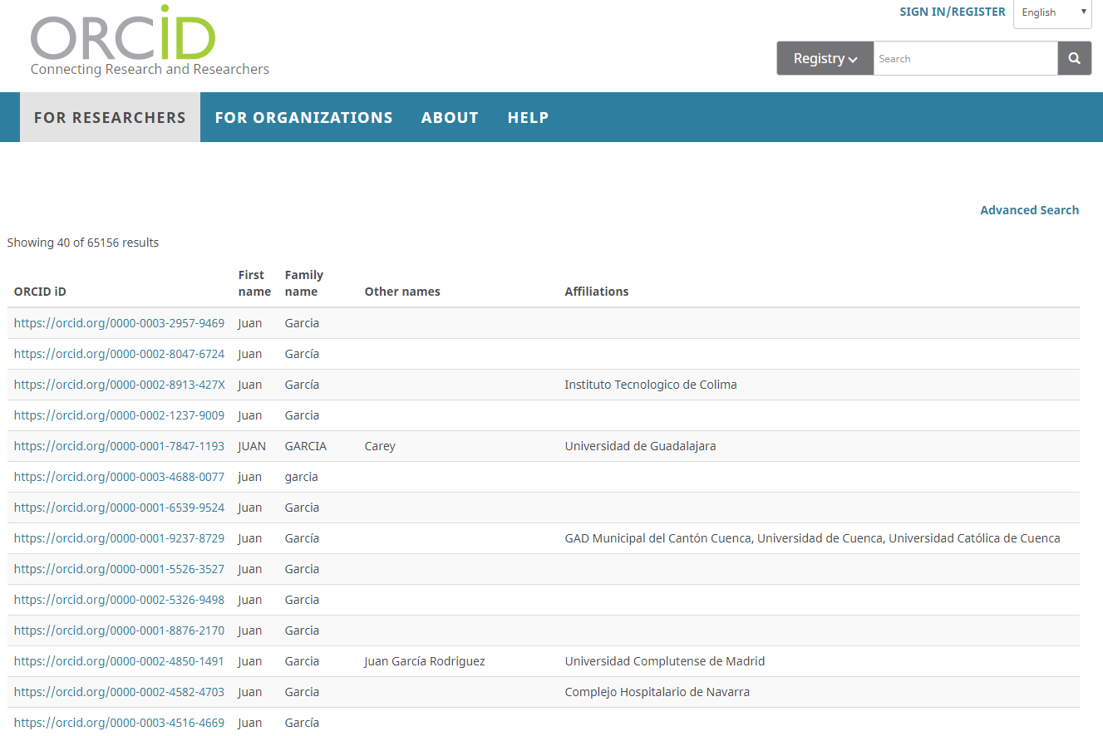

Persistent identifieRs
 | Identifier | Globally unique identifier (guid, uuid) | Persistent identifier (PID)
What | a name that identifies a unique object gene identifier ENSG00000139618 book identifier ISBN 817525766-0 | ensures that there are no two identical identifiers that point to different digital objects 123e4567-e89b-12d3-a456-426614174000 | ensures that the digital object will remain findable over time and reduces the risk of broken links
How | can be (arbitrarily) assigned by anyone | by using a mechanism (e.g. using a registry service) for assigning identifiers | is determined by the commitment of the organisation that assigns and manages the identifier
Examples of globally unique, persistent identifiers
Identifier:
Organisation:
Scope:
Digital objects
Researchers
Research organisations
Notes:
Guid: registry service - cannot possibly assign the same identifier to different resources, or assign an identifier that has already been assigned via some other mechanism/organisation,
Who does the counting? A central authority?
Who handles simultaneous requests and eliminates duplicates?
Can IDs be shared between products? Is Social Security Number 1 different from ISBN 1?
Can people guess what the next ID will be? How many IDs have been issued?

Slide 21

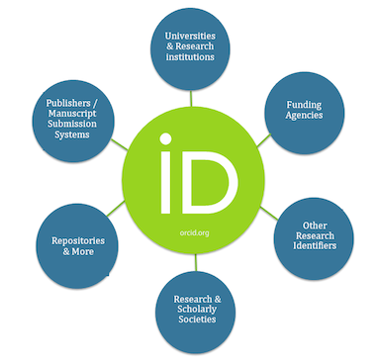






ORcID for identification of researchers
Connection to contributions and affiliations
Unambiguous identity
Commonly used and required
ORCID: Open Researcher and Contributor ID
https://www.slideshare.net/AusAccFed/orcid-coi-19072016

Slide 22





PID: persistent identifier
Globally unique: an unambiguous reference for humans or machines, an identifier associated with only one resource at any time
Persistent: stable and resolvable identifier for the long term
e.g. DOI: Digital Object Identifier
https://www.myserver.be/data/mydata.csv
https://www.myNEWserver.be/data/mydata.csv
https://doi.org/10.1594/PANGAEA.928079

Slide 23
Data repositories & FAIR DATA
→ Key infrastructures that provide functionalities to make your data FAIR.
→ Shared responsibilities between repositories and researchers in making data FAIR
FAIR principle | In practice | Repository | Researcher
FINDABLE | Assign a persistent identifier (PID) | ●
 | Data are described with rich metadata | ● | ●
 | Metadata include the PID, are indexed & searchable online | ●
ACCESSIBLE | (Meta)data retrievable via PID using a standardised communications protocol (e.g. html) | ●
 | Authentication and authorisation procedure | ●
INTEROPERABLE | Metadata standards | ●
 | Controlled vocabularies | ● | ●
 | References to other (meta)data | ● | ●
REUSABLE | (Machine readable) license / terms of use | ● | ●
 | Detailed provenance documentation |  | ●
 | Domain standards | ● | ●
Metadata
Shared responsibilities between repositories and researchers in making data FAIR

Slide 24






documentation
WHAT
WHEN
WHERE
HOW
WHO
WHY
metadata
Any contextual information that allows data to be understandable and reusable.
Information about data, recorded in a highly structured way, using a set of defined information fields or elements to be machine readable.
The dataset…
llllllllllllllll lllllllllllll
Title
llllllllllllllll lllllllllllll
lllllllllllllllllllllllllllllllllll
llllllllll llllllllllllllllll
Creator
lllllllllll lllllllllll
lllllllllll lllllllllll
lllllllllllllllllllll
llllllllllllllllllllllll
Abstract
lllllllllllllllllllllllllllllllllll
llllllllll llllllllllllllllll
Keywords
llllllllllllllllllll lllllllllllllll
lllllllllllllll
llllllllllllllllllll lllllllllllllll
llllllll
Temporal scope
llllllllllllllllllll
llllllllllllllllllll
lllllllllllllllllllllllllll
lllllll
lllllllllllll
File type
llllllll
llllllllllllllll llllllllllllll
llllllllllllllllllllllllllllllllll
License
lllllllllllll
llllllllllllllll llllllllllllll
llllllllllllllllllllllll
Related publication
llllllllllllllllllllllllllllllllll
llllllllllllllll llllllllllllll

Slide 25
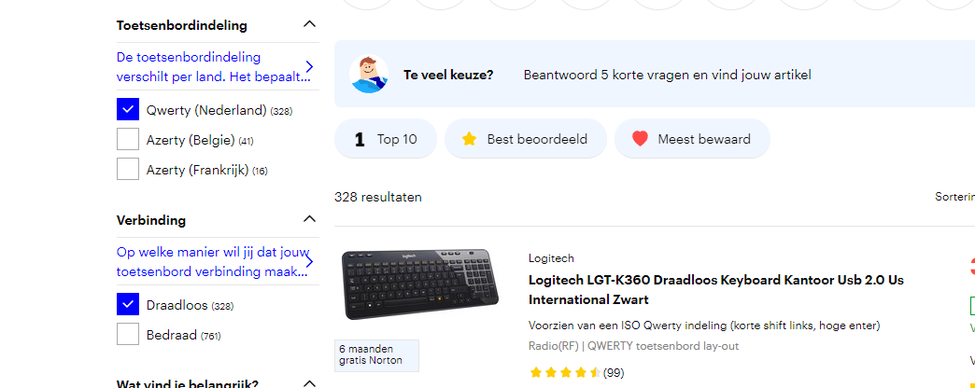
Metadata is data…
About data
A (very) structured type of documentation: records information in sets of pre-defined fields or elements.
Meant to be read & exchanged by machines
To facilitate (online) data discovery
To quickly judge usefulness of data

Slide 26
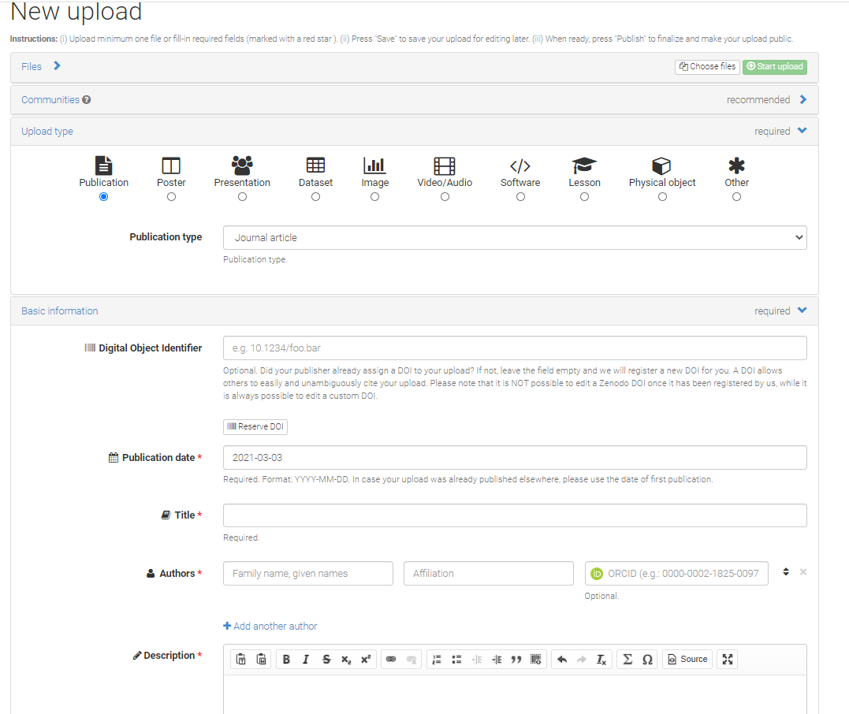
Metadata in data repositories
Zenodo data upload form
Repositories: infrastructure to allow us to share & find data
Provide services to create & manage metadata
Typically, by filling a form with
Pre-defined fields
Lists of controlled terms to choose from (e.g. standard licenses)
Metadata adheres to a specific metadata standard (interoperability)

Slide 27
Data repositories & FAIR DATA
→ Key infrastructures that provide functionalities to make your data FAIR.
→ Shared responsibilities between repositories and researchers in making data FAIR
FAIR principle | In practice | Repository | Researcher
FINDABLE | Assign a persistent identifier (PID) | ●
 | Data are described with rich metadata | ● | ●
 | Metadata include the PID, are indexed & searchable online | ●
ACCESSIBLE | (Meta)data retrievable via PID using a standardised communications protocol (e.g. html) | ●
 | Authentication and authorisation procedure | ●
INTEROPERABLE | Metadata standards | ●
 | Controlled vocabularies | ● | ●
 | References to other (meta)data | ● | ●
REUSABLE | (Machine readable) license / terms of use | ● | ●
 | Detailed provenance documentation |  | ●
 | Domain standards | ● | ●
Vocabularies
Shared responsibilities between repositories and researchers in making data FAIR

Slide 28

Vocabularies and standards
STANDARDIZED METADATA
Metadata fields or
elements
Metadata values
Vocabularies, ontologies, ISO standards
Title
llllllllllllllll lllllllllllll
Creator
ORCID
Description
lllllllllllllllllllllllllllllllllll
llllllllll llllllllllllllllll
Subject
llllllllllllllllllll lllllllllllllll
Date
ISO-…
Format
llllllll
Rights
lllllllllllll
Related identifier
llllllllllllllllllllllllllllllllll
llllllllllllllll llllllllllllll

Slide 29




Controlled vocabularies to standardize terminology
Temperature
April,5th?
Time
May, 4th?
05/04/85
T
DATA
Temperature | temp | T
Humidity | hum | H
METADATA
VOC
Controlled vocabulary
Temperature
1985-04-05
1985-04-05
Temperature
1985-04-05
Temperature

Slide 30
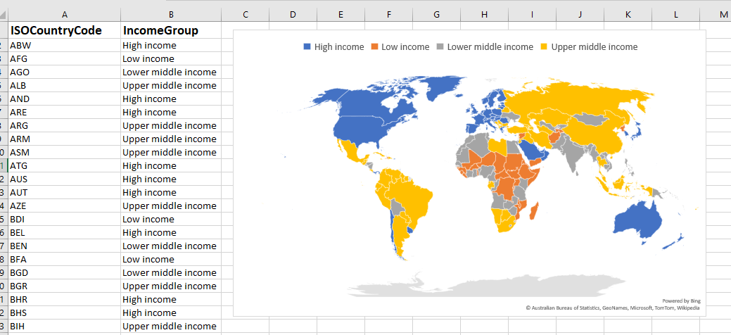

Standard vocabularies & ontologies
Enable machine readability (use might be required in some domain repositories)
Day-to-day example:
MS Excel recognizes ISO Country codes (or other place names in geonames.org) to automatically create maps

Slide 31
Finding repositories

Slide 32










Which types of repositories exist?
Types of repositories
GENERIC REPOSITORY
DOMAIN-SPECIFIC REPOSITORY
INSTITUTIONAL REPOSITORY

Slide 33






How to select a data repository?
Recommended repositories
RESEARCH DOMAIN’S
CONSENSUS
RESEARCHERS’
BEST PRACTICES
JOURNAL
RECOMMENDATIONS
DATA REPOSITORY
REGISTRIES
e.g. data repositories
recommended by Nature
re3data.org demo

Slide 34
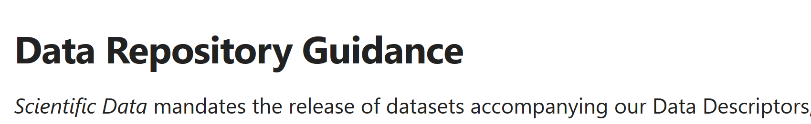
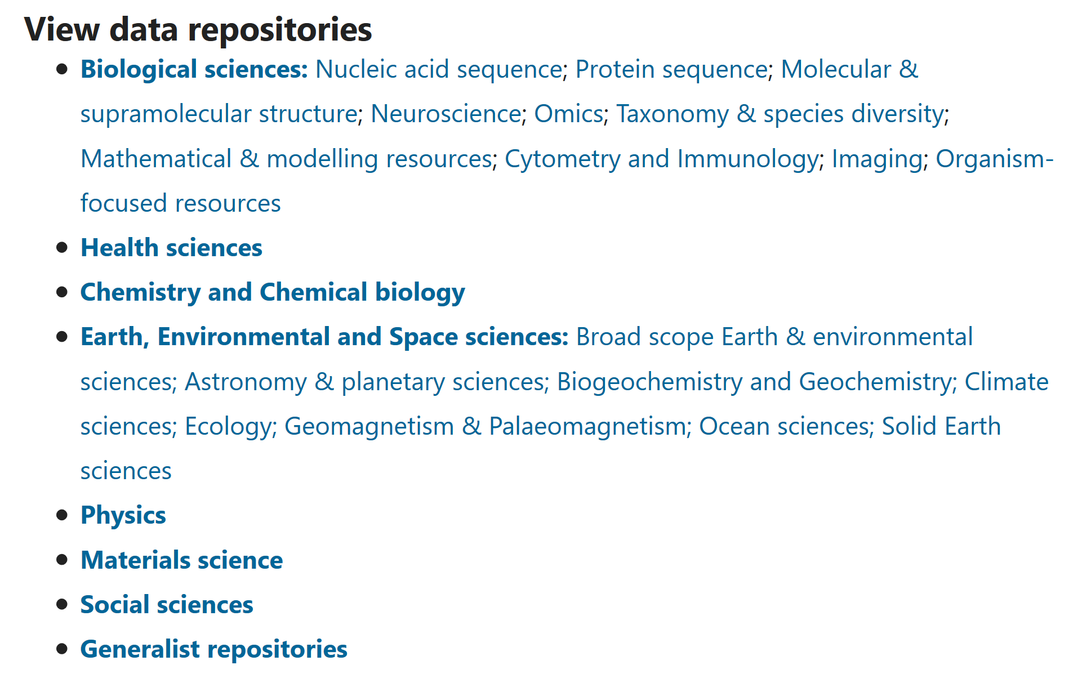
How to select a data repository?
Does your publisher or funder recommend a repository?
For example:
Source: a list of data repositories

Slide 35

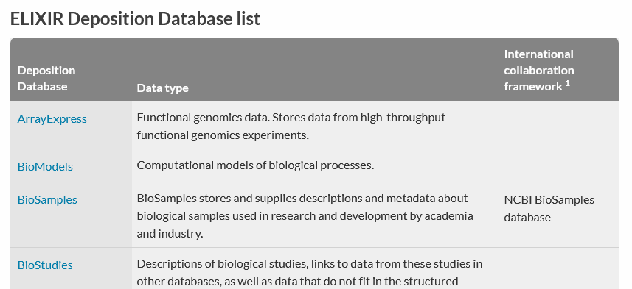
How to select a data repository?
Does your publisher or funder recommend a repository?
For example:
Deposit data in a trusted repository and provide open access to it (‘as open as possible, as closed as necessary’)
https://elixir-europe.org/platforms/data/elixir-deposition-databases

Slide 36
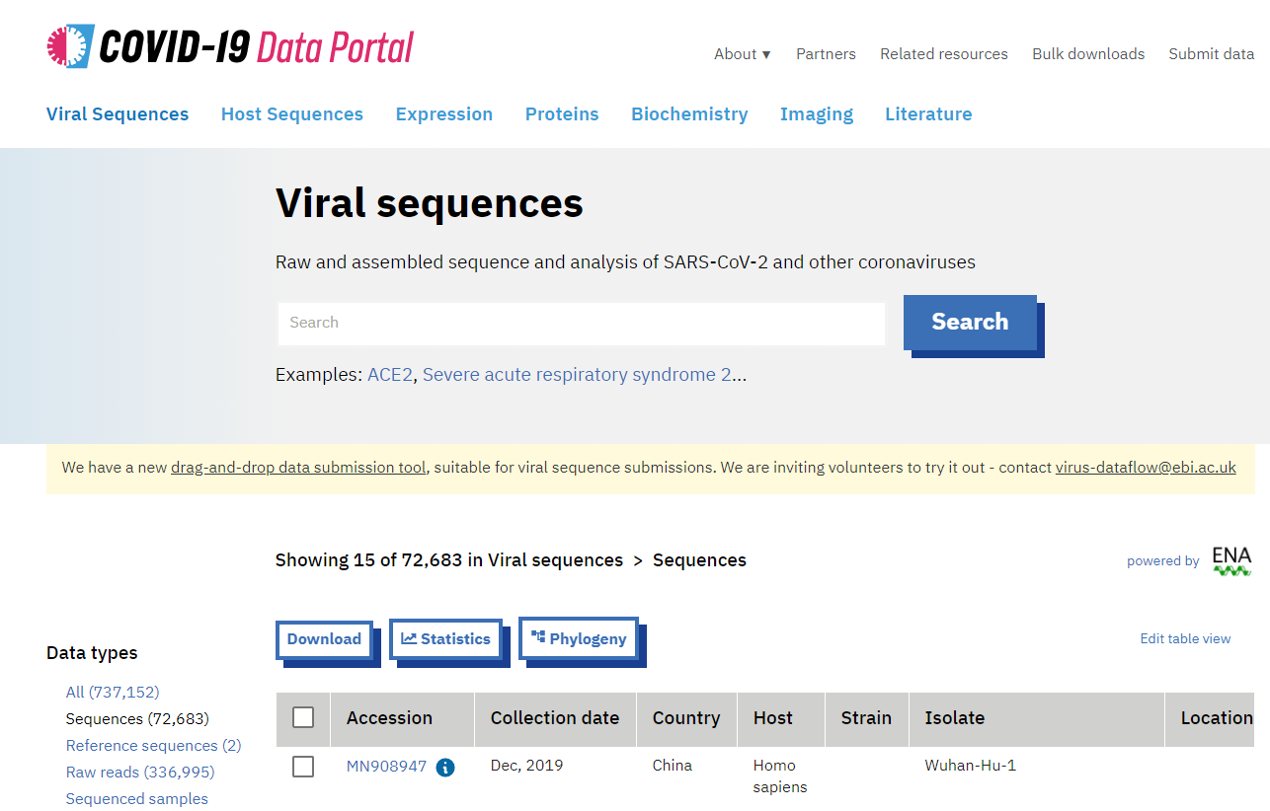
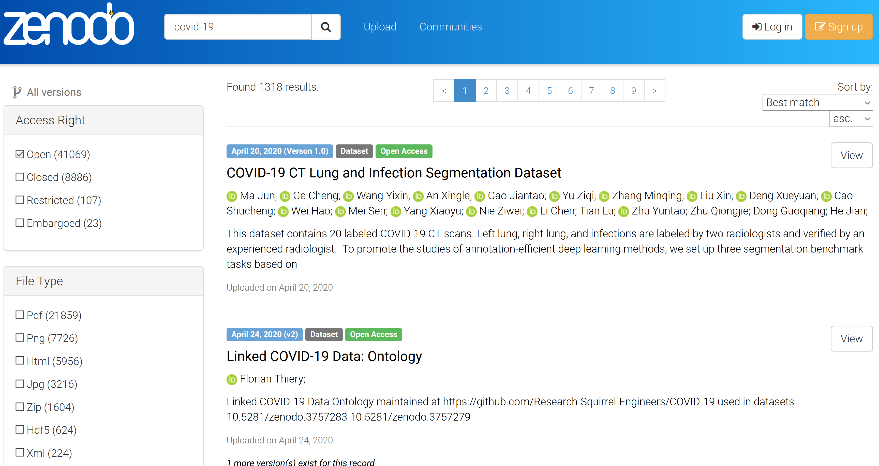
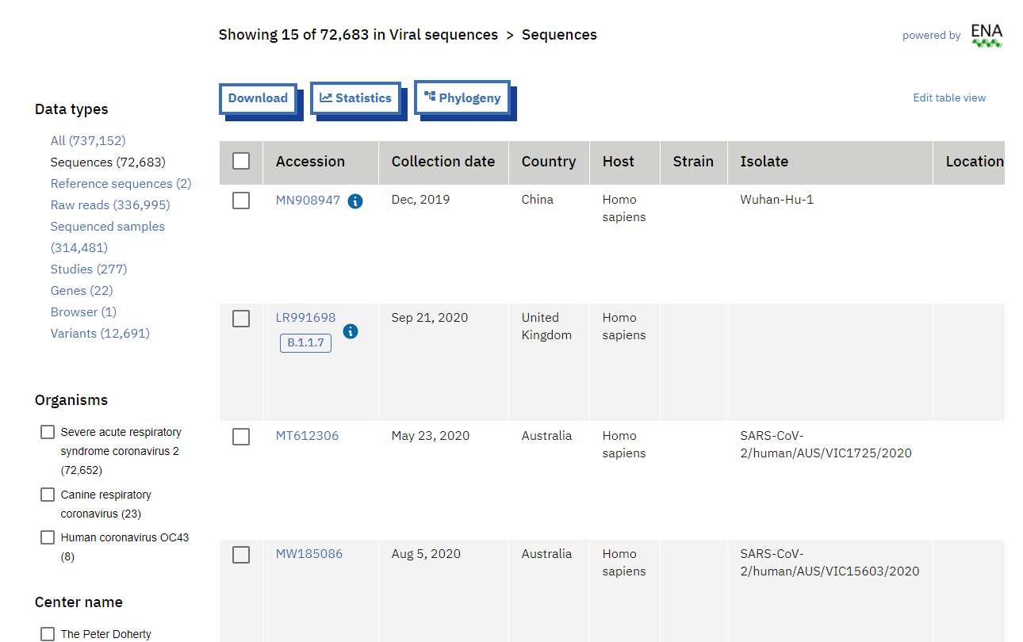
Generic vs. domain-specific repositories
COVID-19 datasets in Zenodo
COVID-19 data portal

Slide 37
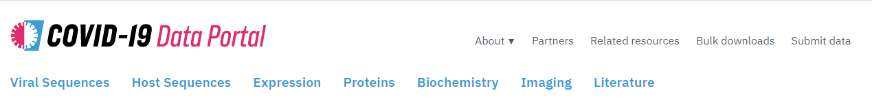
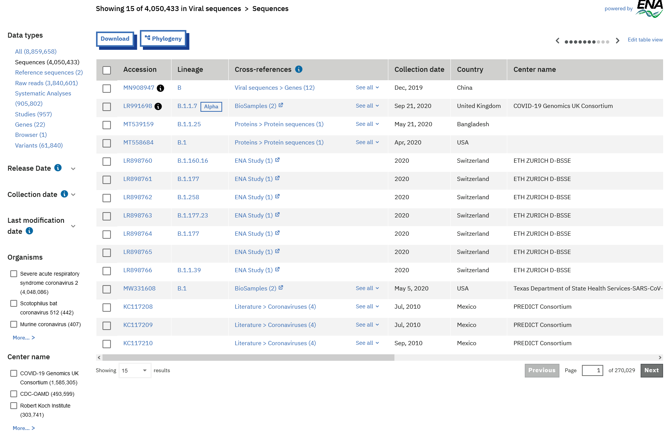
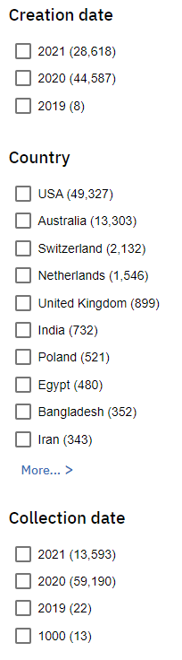
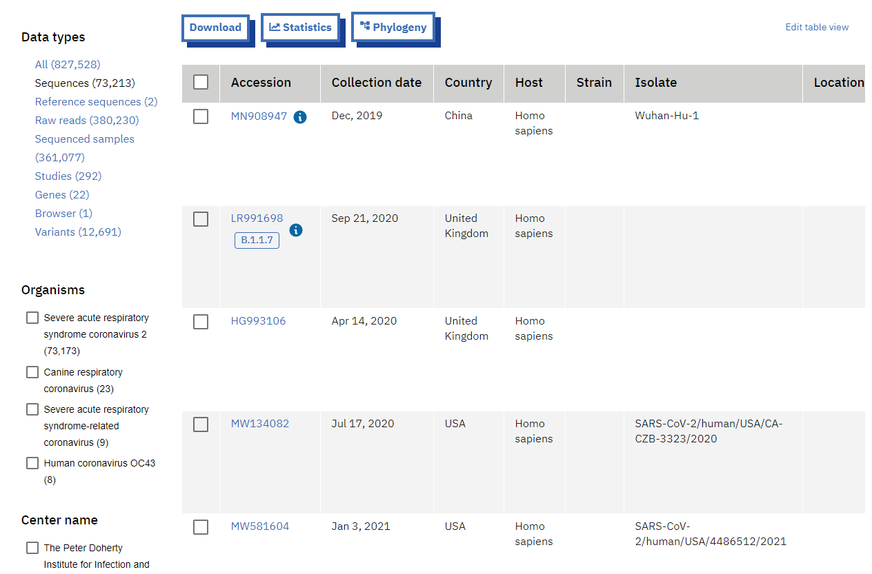
EXAMPLE of a domain-specific repository COVID-19 data Portal

Slide 38

Generic vs. domain repositories
Domain-specific repositories
Visibility: where your peers will likely look for data
Use of discipline standards & vocabularies
Search filters, visualization tools tailored to domain
Interoperability: easier to integrate multiple datasets
Dataset curation by repository advisors often part of submission process
Generic repositories:
Provide rich metadata to make it more findable & reusable
Generic AND domain:
DOI, link to publication(s), dataset(s) or other outputs
Support minimum degree of FAIRness

Slide 39
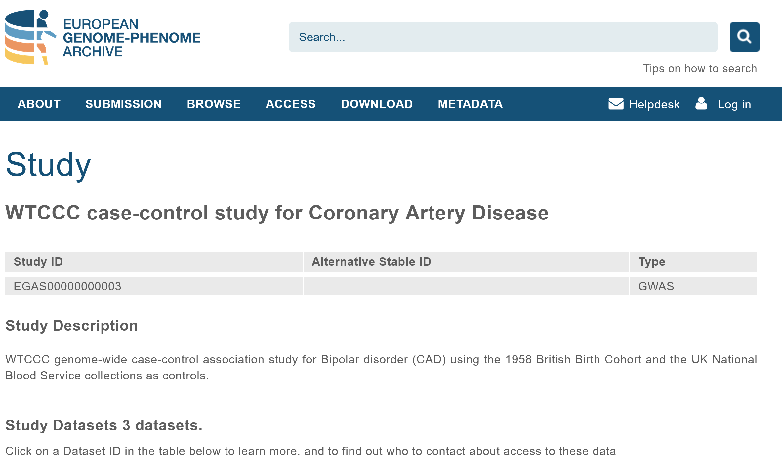






Domain specific: life sciences

Slide 40
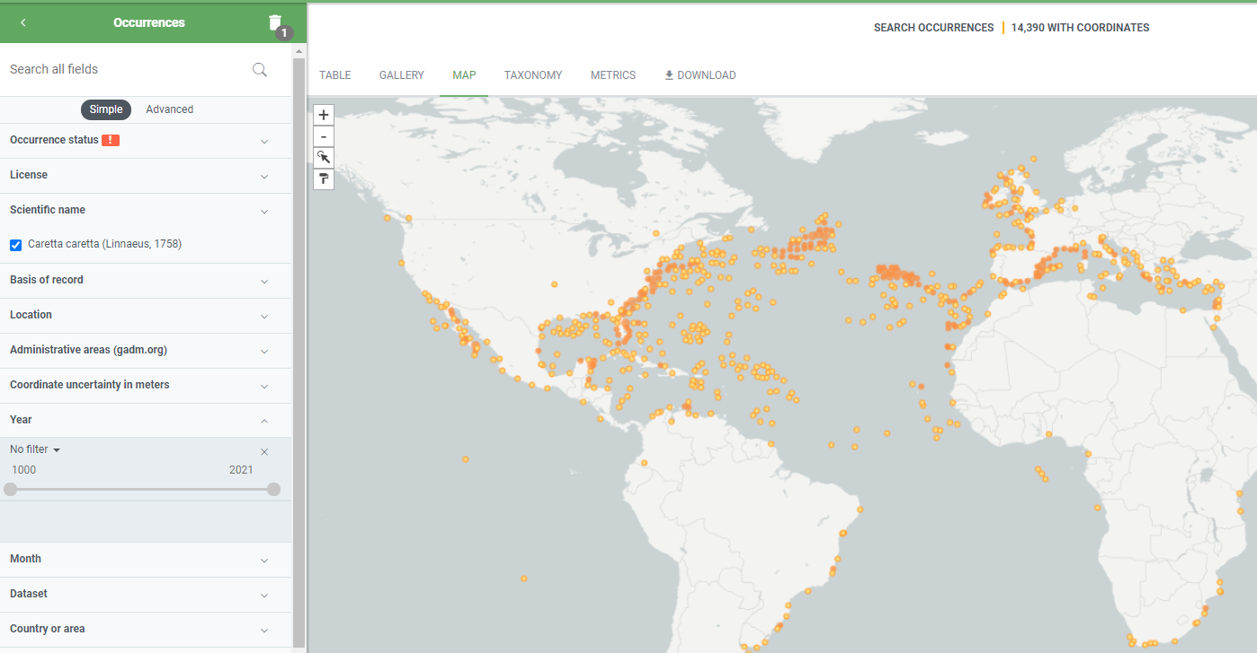
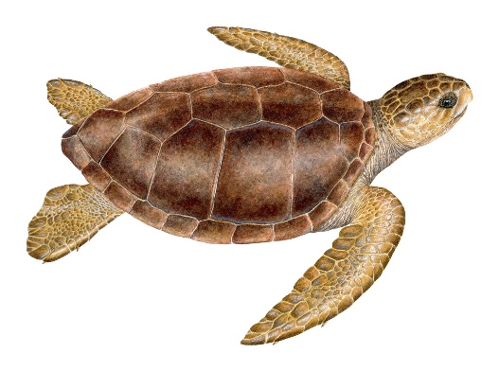
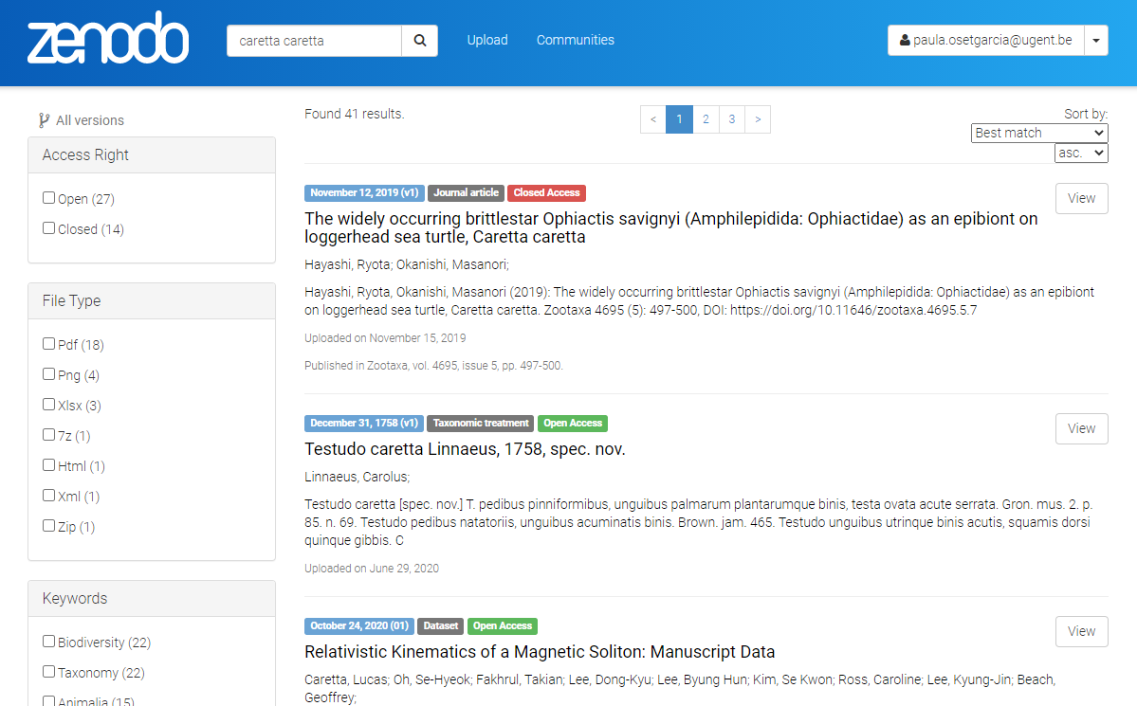
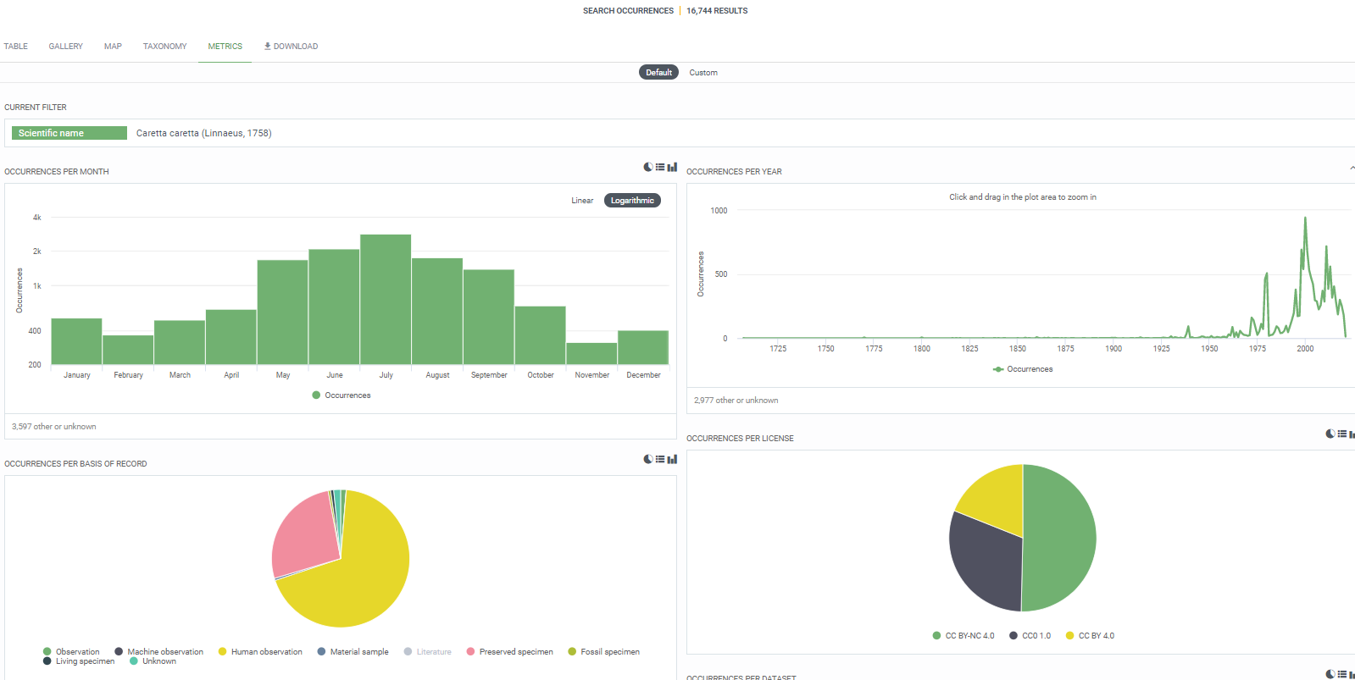
“Caretta caretta” in GBIF
Search filters tailored to domain & data type -> facilitated by domain metadata standard
Data visualization -> facilitated by data standardization
“Caretta caretta” in Zenodo

Slide 41
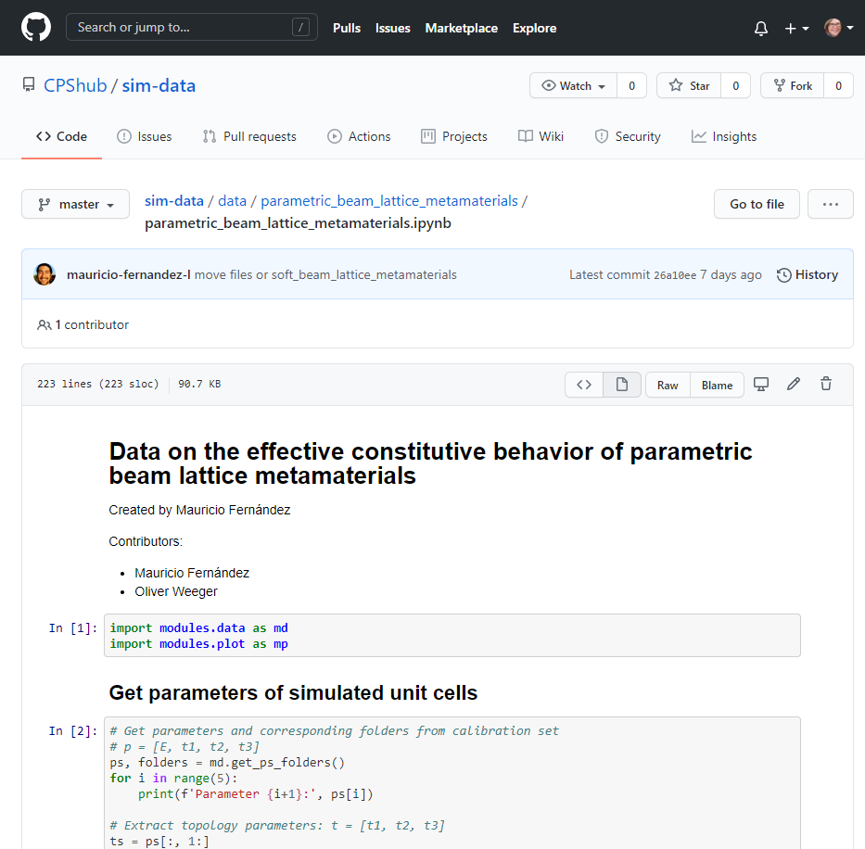

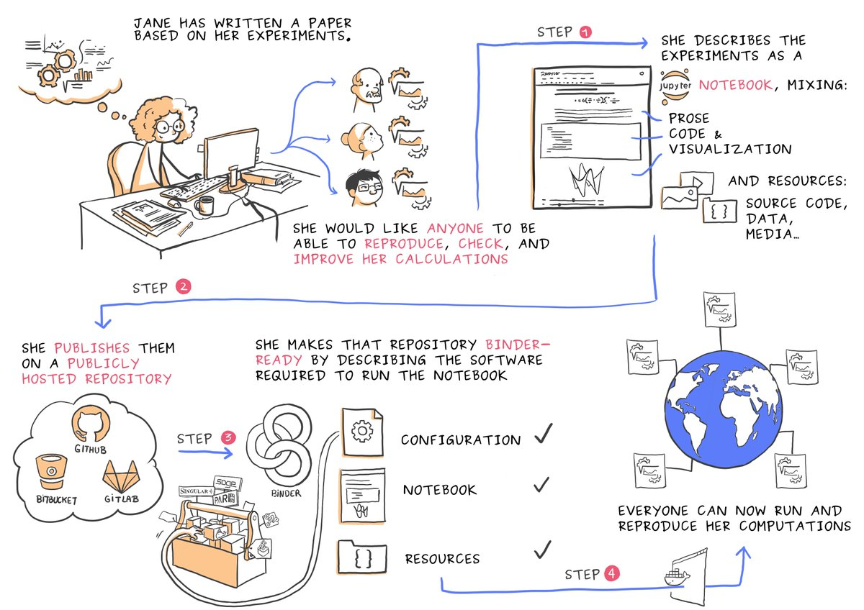


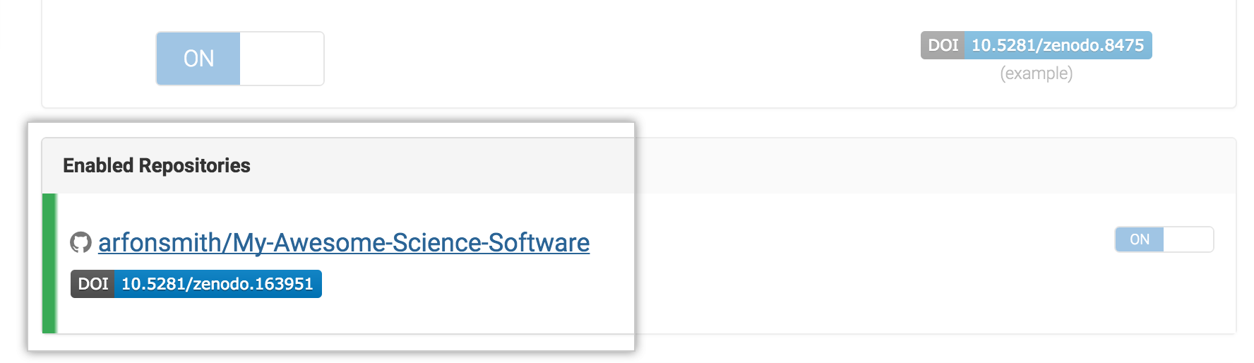

repositories FOR software and data analysis
Run and publish notebooks
Jupyter notebooks
https://github.com/CPShub/sim-data
https://codeocean.com
Publish git repositories
https://opendreamkit.org/2017/11/02/use-case-publishing-reproducible-notebooks/
https://guides.github.com/activities/citable-code/

Slide 42
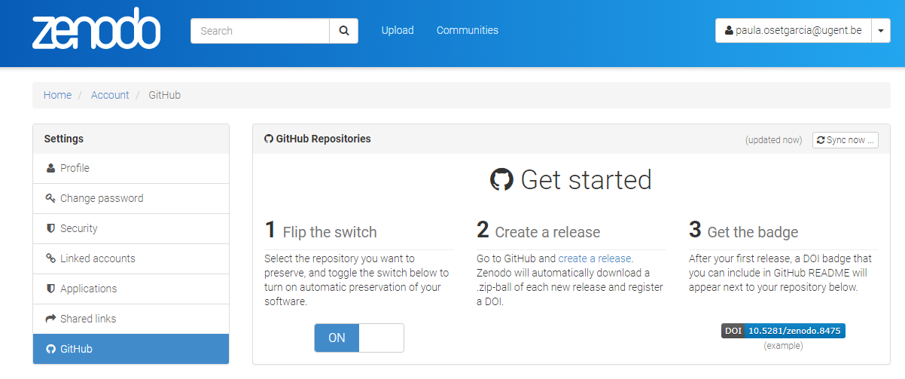
Sharing code and making code citable
GitHub – Zenodo integration: https://guides.github.com/activities/citable-code/

Slide 43

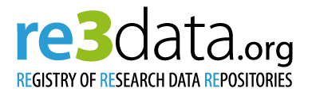


THE JOURNEY TO FAIR DATA
Plan for data management, keep your DMP updated
Document as you go
Notebook
Codebook, data dictionary
Workflows
Protocols
Readme files
Data overview with metadata
File organization and naming
Check regulations.
Explore potential data repositories and their requirements & guidelines.
Inc. use of standards, vocabularies, etc.
Deposit data & documentation in repository; describe it with rich metadata, inc. access & reuse conditions
Adopt domain standards during data collection & processing
Implement regulatory requirements

Slide 44
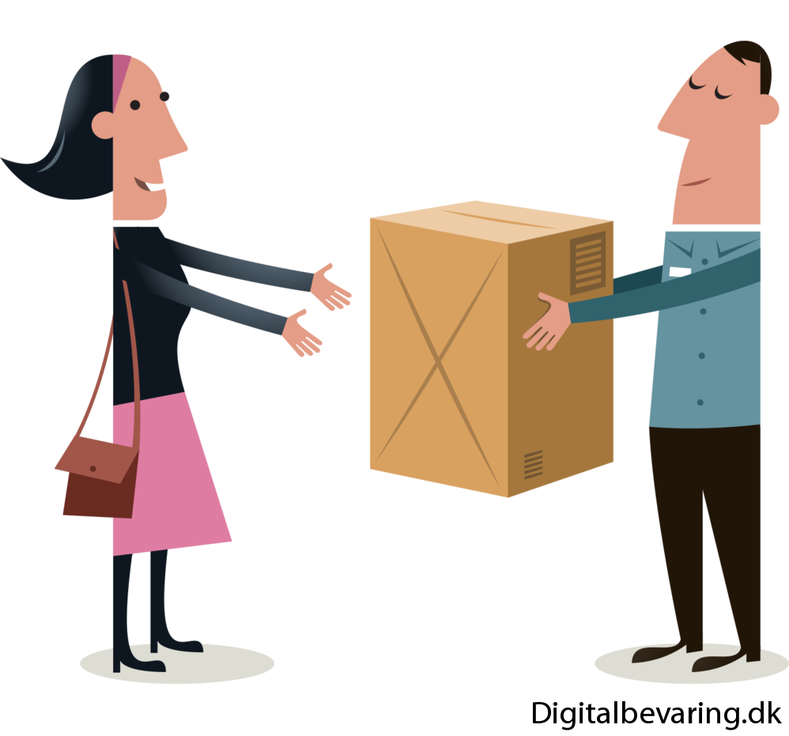
Preparing data Data deposition checklist (generic)
Gather all relevant (meta)data needed for reproducibility:
experimental method details, raw data files, organized data tables, scripts and code, data visualizations, and statistical output
Migrate data to recommended, reusable formats
Organize files in a logical schema
Provide a separate readme file
Jørgen Stamp - Digitalbevaring.dk
More info at: https://datadryad.org/stash/best_practices

Slide 45
Data linked to article publication
https://doi.org/10.1098/rspb.2022.2456
Neutral processes underlying the macro eco-evolutionary dynamics of mixed-ploidy systems
Felipe Kauai, Frederik Mortier, Silvija Milosavljevic, Yves Van de Peer and Dries Bonte
All relevant data are within the manuscript and its electronic supplementary material. The code developed for running numerical simulations is available on a GitHub repository at https://github.com/KauaiFe/Polyploidy-V1.0. Readers will also find the code documentation within the electronic supplementary material
Electronic supplementary material is available online at https://doi.org/10.6084/m9.figshare.c.6456230

Slide 46
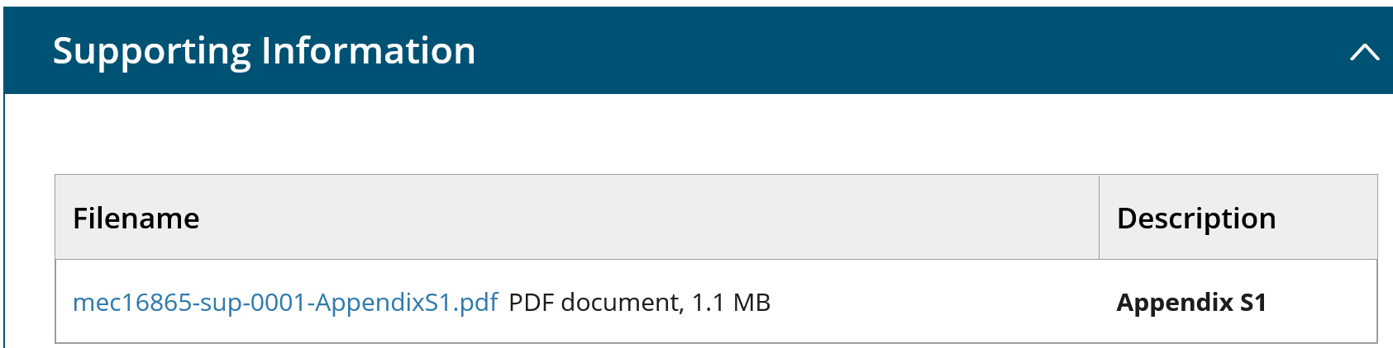
Data linked to article publication
https://doi.org/10.1111/mec.16865
Runs of homozygosity reveal past bottlenecks and contemporary inbreeding across diverging populations of an island-colonizing bird
Claudia A. Martin, Eleanor C. Sheppard, Juan Carlos Illera, Alexander Suh, Krystyna Nadachowska-Brzyska, Lewis G. Spurgin, David S. Richardson
The genomic data supporting this study and code used to perform the data analyses within this article are openly available in the Dryad Digital Repository: https://doi.org/10.5061/dryad.ksn02v75k (Martin et al., 2022).

Slide 47
Data linked to article publication
https://www.ncbi.nlm.nih.gov/pmc/articles/PMC9627755/
At age 9, the methylome of assisted reproductive technology children that underwent embryo culture in different media is not significantly different on a genome-wide scale
Rebekka M Koeck, Florence Busato, Jorg Tost, Heleen Zandstra, Sylvie Remy, Sabine Langie, Marij Gielen, Ron van Golde, John C M Dumoulin, Han Brunner, Masoud Zamani Esteki,and Aafke P A van Montfoort
The raw and processed array data from this study have been uploaded to the Gene Expression Omnibus (GEO) database and are available under the accession number GSE196432 (https://www.ncbi.nlm.nih.gov/geo/query/acc.cgi?acc=GSE196432). The raw array data from the FLEHS study are available within the GEO database under the accession number GSE110128.

Slide 48
Always open sharing?

Slide 49
What about SHARING OF sensitive or confidential data?
“As open as possible, as closed as necessary”
OPEN
RESTRICTED
CLOSED
Can be freely used, modified & shared by anyone for any purpose
Personal data
Confidential data
Sensitive data
3rd party data
Copyright/database right
Valorization potential
Under embargo
Unable to share

Slide 50





Restrictions on data sharing
C
Personal data
Confidential data
Sensitive data
Third-party data
Copyright
Valorization
More info in next sessions!

Slide 51
Take-home messages
Publishing data can provide personal (career) advantages, and it benefits science and society at large
Sharing data is a growing requirement from research institutes, funders and journals
The recommended way to share data is using data repositories
Data repositories provide essential functionalities to make your data FAIR
Check repository requirements to prepare for deposit during research
Putting your data in a repository ≠ making data open

Slide 52



Ghent University Data Stewards research Department - University Library rdm.support@ugent.be @UGentRDM ugent.be/en/research/datamanagement
Please reuse content of this presentation, and attribute to: Ghent University Data Stewards, CC BY 4.0

